Slide 1
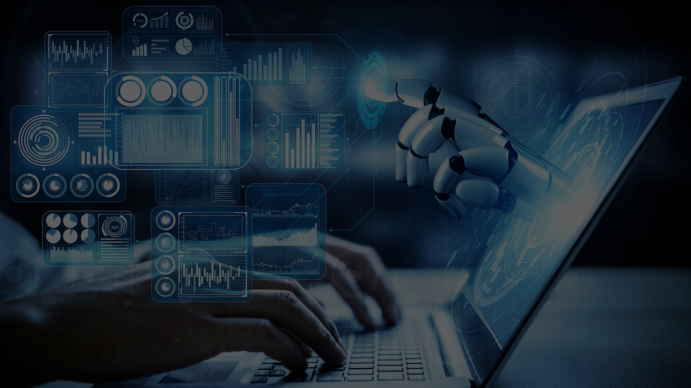
THE IMPACT OF ONLINE MARKETING IN
TODAY’S WORLD
1

Slide 2
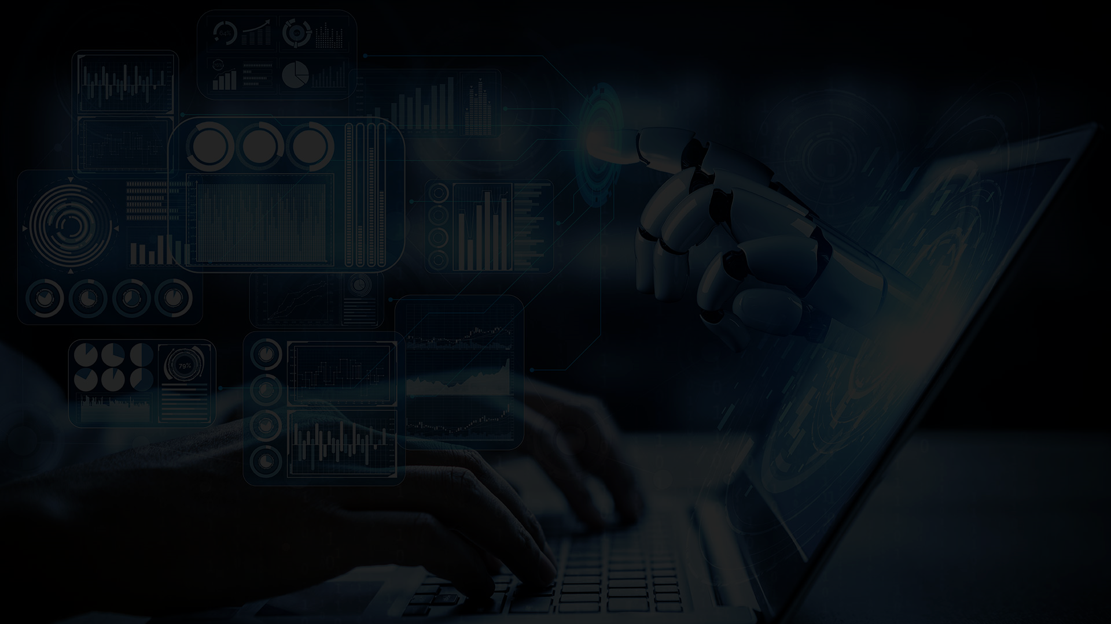
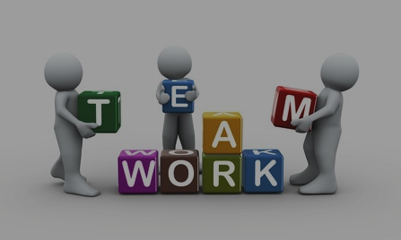
Our Team
D.N.M.Dissanayake IT21185748
E.M.D.K.L.Ekanayake IT21186042
G.M.J.K.Gunathilake IT21186660
W.B.M.S.Sriyarathne IT21185366
E.M.T.S.Edirisingha IT21185434
2

Slide 3

01
Introduction and Methodology
02
Digital Platforms in Online Marketing
03
Process of Online Marketing
04
Traditional Marketing vs Digital Marketing
05
Benefits and Importance of Online Marketing
Content
06
Conclusion
3

Slide 4
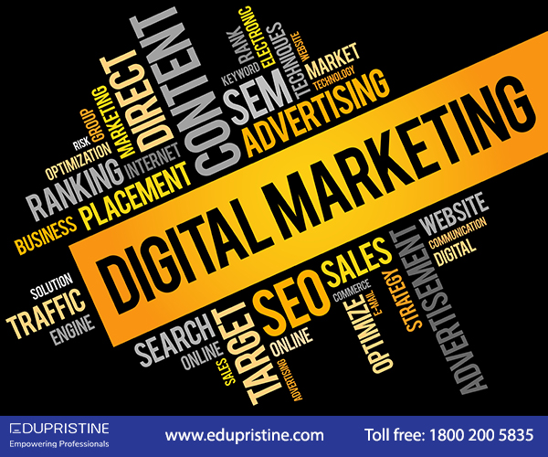
Introduction
D.N.M.Dissanayake IT21185748
4

Slide 5
Online marketing is the process of promoting a brand, service, or product via the internet.
Widely E-mail and technology enabled to manage the web presence relatively easily.
Many small businesses operate to decide which type of marketing to pursue.
5

Slide 6
Methodology
The data for this report was collected mainly via articles and resources on the internet. In addition to that, we use scholarly articles and research papers available online.
6

Slide 7
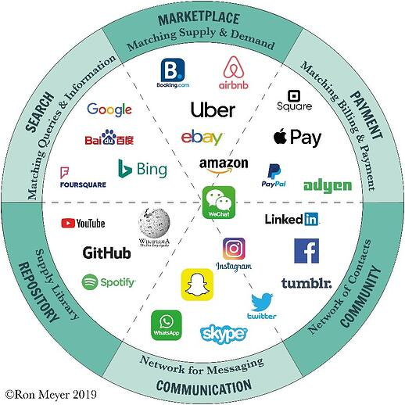
Digital platforms in Online Marketing
W.B.M.S.Sriyarathne IT21185366
7

Slide 8
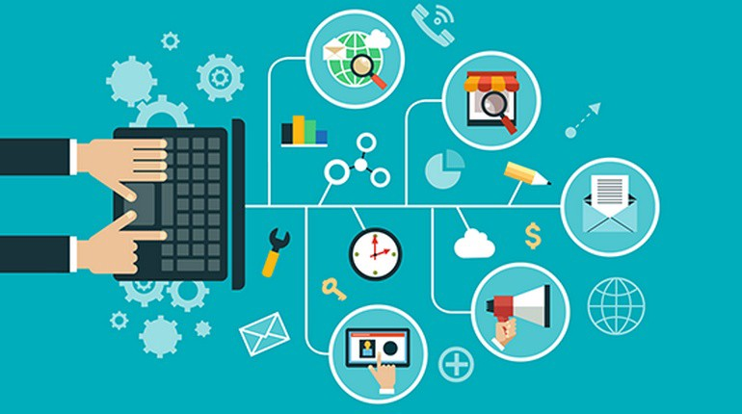
Internet Marketing
In network computers can communicate with each other’s in the system.
An organization will communicate with its internal and external staff.
8

Slide 9
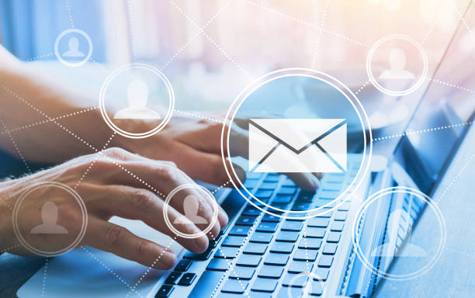
E – Marketing
Growth of electronic commerce affected to developments in internet technology.
Products or services are bought and sold using electronic systems.
9

Slide 10
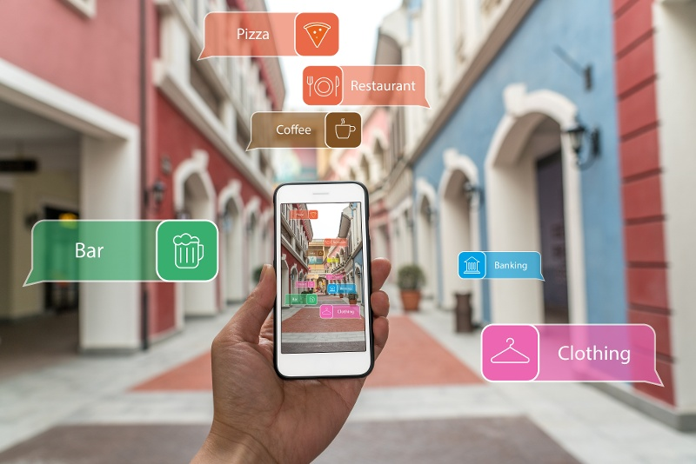
Mobile Marketing
Latest developments in marketing and communications.
Set of practices that enables organizations to communicate and engage with their audience.
10

Slide 11
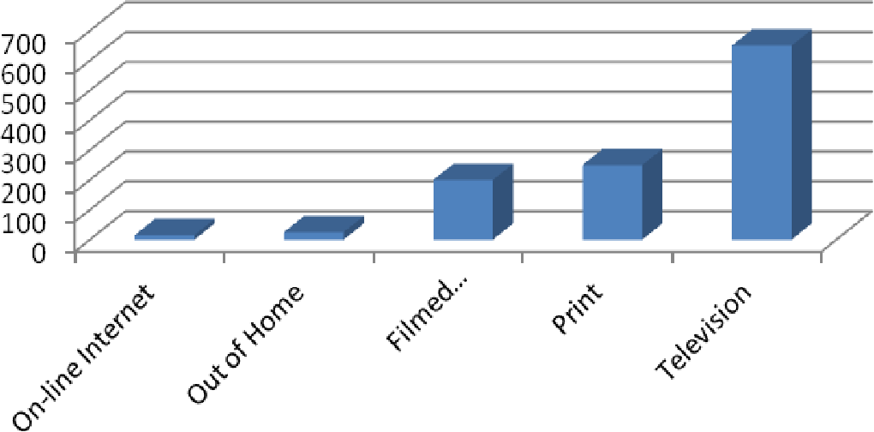
Interactive Television Marketing
Type of media convergence that incorporates data services into traditional television technology.
Using remote controls viewers can interact with tv programming and advertising.
11

Slide 12
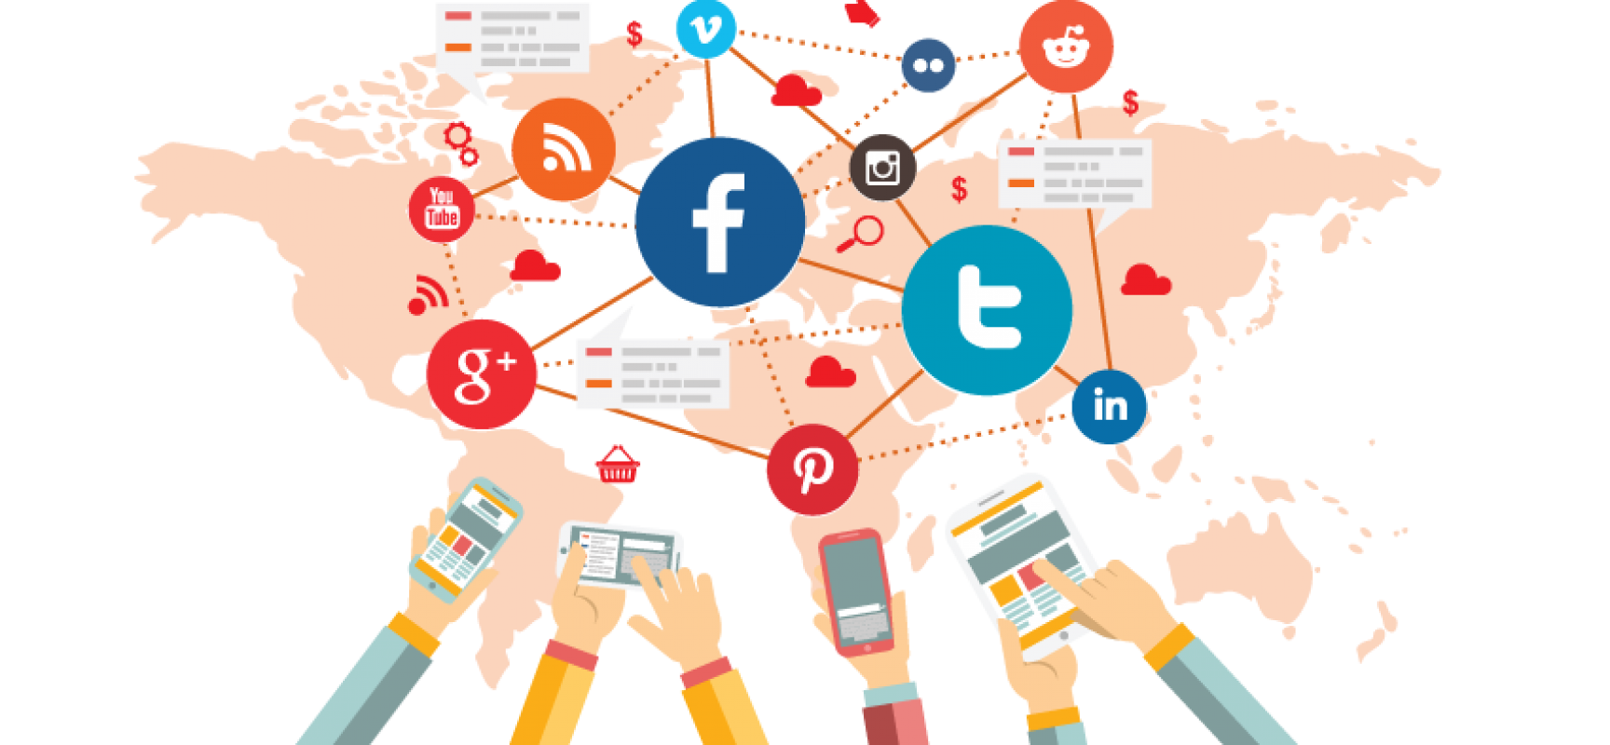
Social Media Marketing
Type of Internet marketing that uses social media as a marketing tool.
Focus on efforts to create content that captures readers' attention.
12

Slide 13
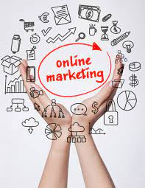
Process of Online
Marketing
01
02
Content Here
Easy to change colors, photos and Text
G.M.J.K.Gunathilake IT21186660
13

Slide 14
Process of Online Marketing
Create an online marketing plan
It should responsive and represent company well
Evaluate website and fix real problems
Visitors want current information, and new business opportunities.
Use web analytics to learn from visitors
Determine the number of visitors visit to the web site.
14

Slide 15
Promote website via Pay-Per-Click
This is a way to drive traffic to website by paying a publisher every time.
Search engine optimization
Process of optimizing web site to rank higher in search engine result.
Maintain the quality of website
The web site must be updated daily.
15

Slide 16
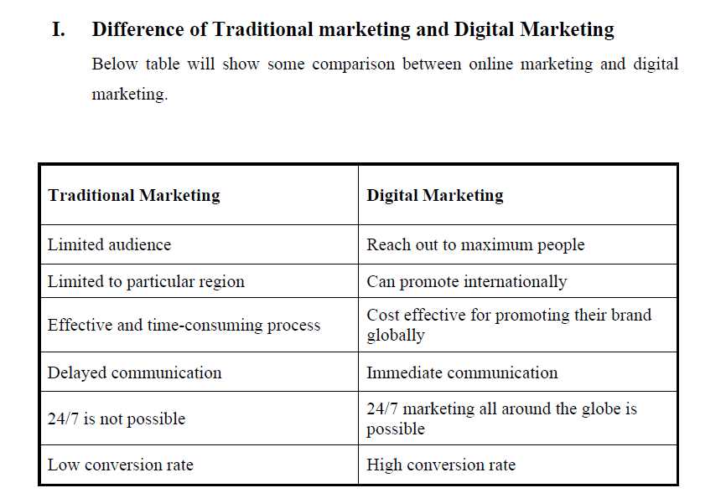
E.M.D.K.L.Ekanayake IT21186042
Traditional Marketing vs Digital Marketing
16

Slide 17
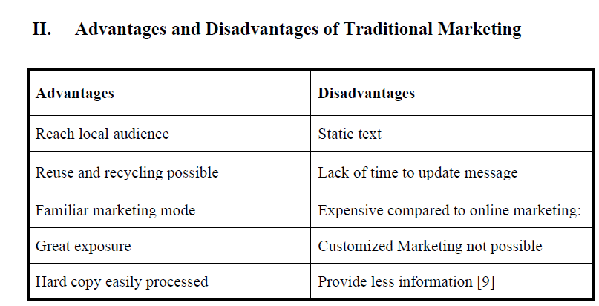
17

Slide 18
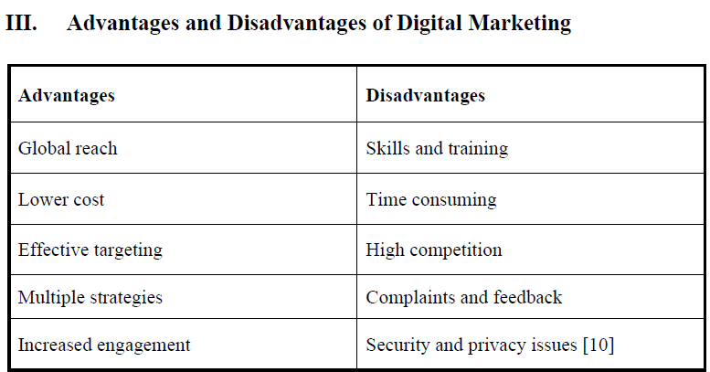
18

Slide 19
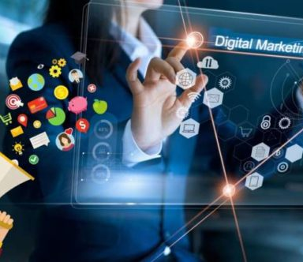
Benefits and Importance of
Online Marketing
E.M.T.S.Edirisingha IT21185434
19

Slide 20
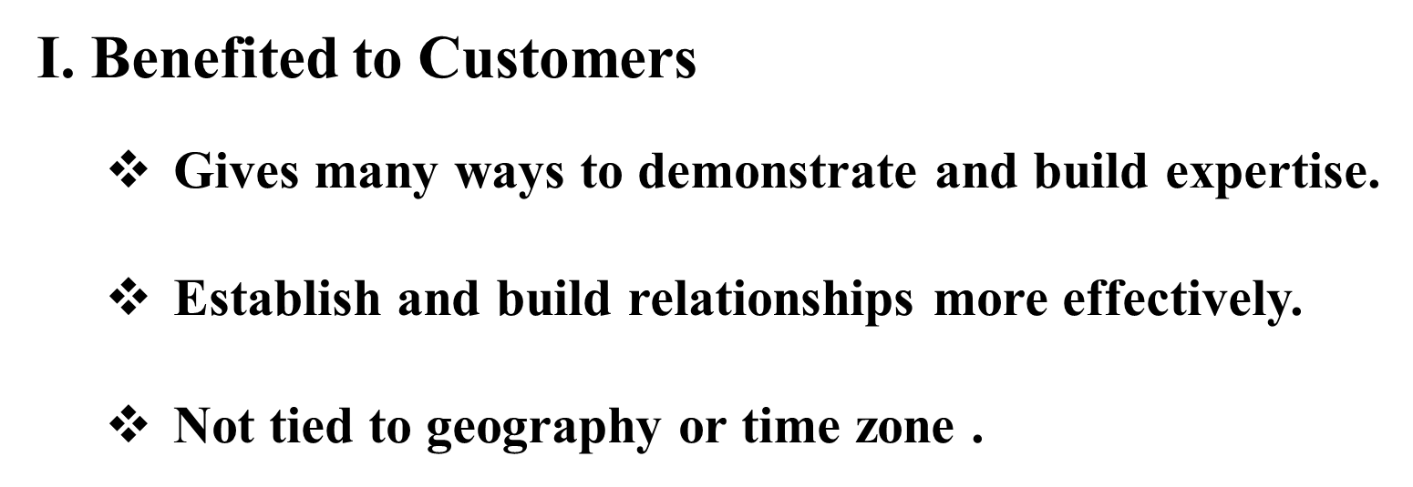

20

Slide 21
II. Benefited to Businesses
E-marketing planning process.
Organizing and resourcing for e-marketing.
Defining the internet value proposition.
21

Slide 22
Recommendation
E.M.D.K.L.Ekanayake IT21186042
22

Slide 23
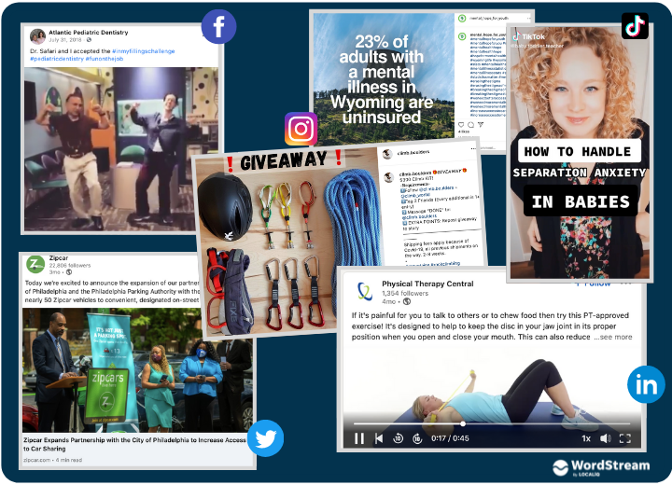
On Demand model - based on consumers' abilities to select and choose their content and interactions with brands.
The engagement model - where visitors are engaged in the product or service.
Advertising as service to consumers - where the simplicity of a website becomes an advantage
23

Slide 24
CONCLUSION
Online marketing allows companies to allocate marketing resources to the right channels.
Since COVID-19 pandemic started, online marketing has become a necessity now.
As consumer’s buying behavior changes, businesses will need to change their advertising strategies and use digital platforms for marketing.
24

Slide 25
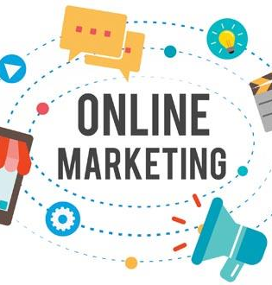
Reference
25

Slide 26
[1] Teresa Piñeiro-Otero, Xabier Martínez-Rolán, “Understanding Digital Marketing - Basics and Actions,” in MBA: Theory and Application of Business and Management Principles, Carolina Machado and J. Paulo Davim, Eds., Cham, Switzerland: Springer International Publishing, 2016, pp. 37-74. [Online]. Available: https://www.researchgate.net/publication/312190728_Understanding_Digital_Marketing-Basics_and_Actions. [Accessed: April 14, 2022]
[2] Sri Lanka Institute of Marketing (SLIM), “Introduction to Marketing & the Marketing Process,” in Professional Certificate in Marketing (PCM), Colombo, Sri Lanka: Sri Lanka Institute of Marketing (SLIM), 2021
[3] “Impact of Digital Marketing on Businesses,” Digital Marketing (2017) srvmedia.com. [Online]. Available: https://www.srvmedia.com/blog/impact-digital-marketing-businesses/ [Accessed: April 15, 2022]
[4] “1 in 3 Online Consumers Want to Interact with TV Shows Via a Second Screen,” (2012) marketingcharts.com. [Online]. Available: https://www.marketingcharts.com/television-25264.
26

Slide 27
5] “Most popular social media platforms in 2022,” (2022) oberlo.com. [Online]. Available: https://www.oberlo.com/statistics/most-popular-social-media-platforms
[6] Jonathan Hochman, “The Internet Marketing Process.” (2019) hochmanconsultants.com. [Online]. Available: https://www.hochmanconsultants.com/the-internet-marketing-process/. [Accessed: April 13, 2022]
[7] “Difference Between Traditional Marketing and Digital Marketing.” (2021) keydifferences.com. [Online]. Available: https://keydifferences.com/difference-between-traditional-marketing-and-digital-marketing.html.
[8] Ms. A. Lavanya and Mrs. M. Radhikamani, “A Study on Digital Marketing and it’s Impacts,” International Journal of Creative Research Thoughts (IJCRT) 5 May 2021, ijcrt.org, vol. 9, ISSN: 2320-2882
27

Slide 28
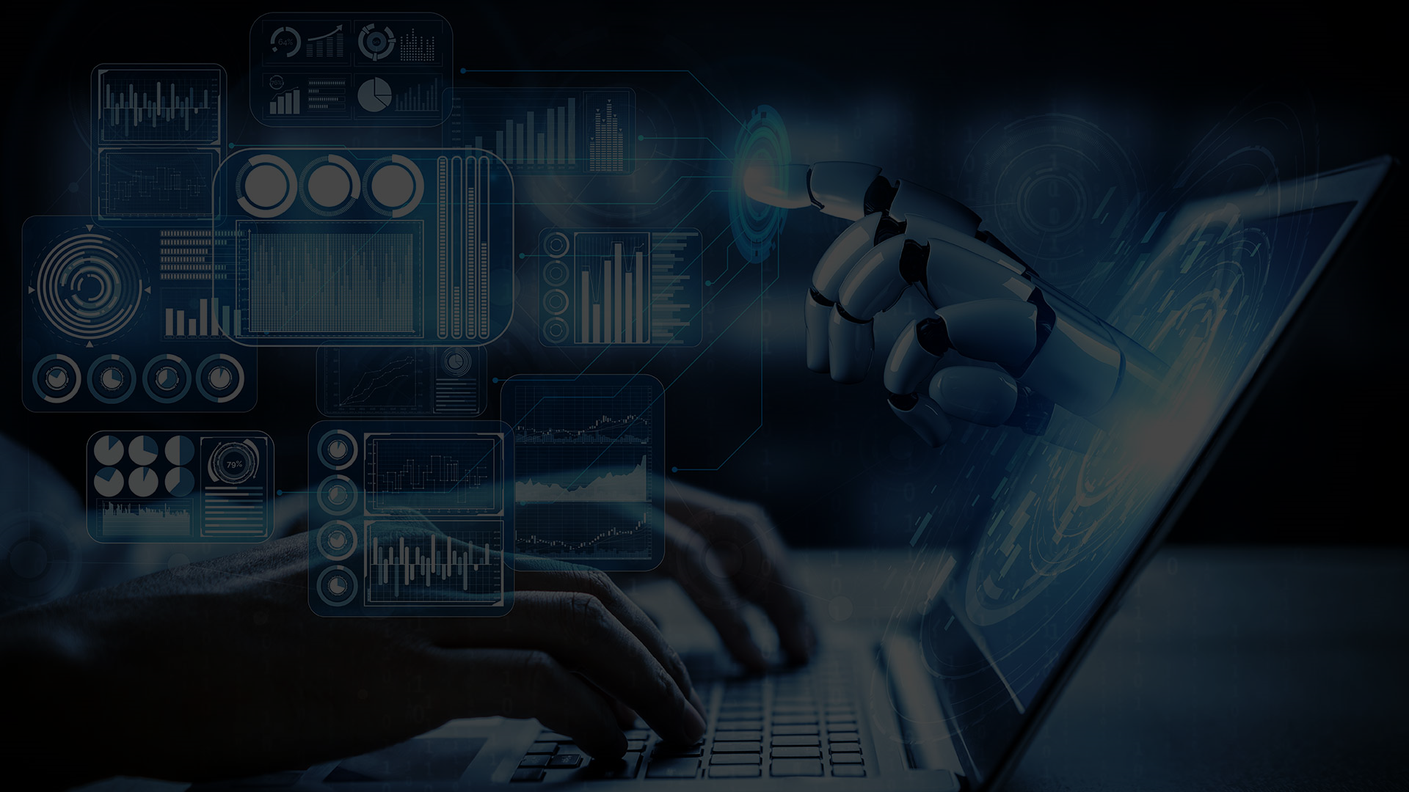
THANK YOU
28

